Slide 1
Chiba Campaign 2019
11.26 Report
DAIYAJIE

Slide 2
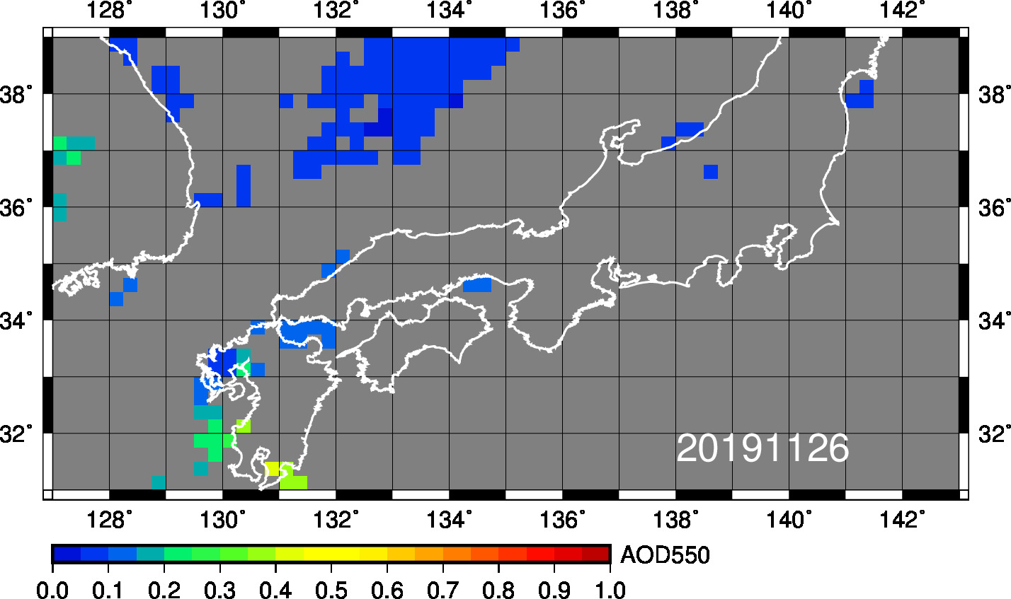
MODIS

Slide 3
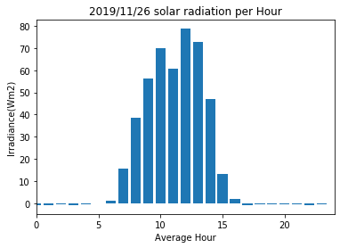
Figure:The average of Solar Irradiance per hour was observed at chiba university

